Slide 1
Model Based Development
S. Ramesh
GM R&D

Slide 2
Model-based Development
Models are abstract and high level descriptions of design objects
Focus on one aspect at a time
Less development and redesign time
Implementation constraints can be placed on models
Models of Plant essential for early validation
Design exploration, evaluation and quick prototyping possible using models

Slide 3
Embedded Systems
Plant
Controller
A very High-Level Picture
Plant is the physical system under observation & control
  E.g., Heating/Colling Chamber (HVAC), Car ( Autonomous vehicle), Motor (Motor control system)
Controller is the electronic & SW system we develop
  E.g., HVAC controller, Adaptive Cruise Control (ACC)
Environment – Not shown here

Slide 4
Model based development
Plant Model
Link Model
Ctrl. Model
Code Generation
Plant
Controller

Slide 5
Modeling Languages
Models need to be formal
Languages for describing models
Various languages exist
High level programming languages (C, C++)
Finite State Machines, Statecharts, SpecCharts, Esterel, Stateflow
Data Flow Diagrams, Lustre, Signal, Simulink
Concurrent Languages (CSP, SDL)
Hardware description languages (VHDL, Verilog)
Unified Modeling Language(UML)

Slide 6
Visual Languages
Modeling Languages for domain experts- non SW Engineers.
Visual Languages have been successful
  `A picture is worth a thousand words’
  UML has nine kinds of diagrams
But visual languages often informal and imprecise
  Precise semantics required for reasoning, execution and code generation
They are not succinct
  Several pages of pictures for a few lines of text
The challenge: intuitive, precise and succinct language

Slide 7
Block Structured Languages
Many successful modelling languages
  Simulink, SCADE, SDL, MatrixX
Blocks and their interconnections
Concurrent and communicating blocks
Basic and hierarchical blocks
Basic blocks are arithmetic and conditional blocks
Specialized blocks
  Input and output blocks
  State machine blocks, Transform blocks
  Integration blocks
Libraries of Customizable blocks

Slide 8
Important Features
Precise Syntax
Rich high level constructs
Executable Semantics
Simulation aids & verification tools
Autocode generation capabilities

Slide 9
Types of Blocks
State-machines
Computational blocks
Data flow models
Synchronous Concurrency

Slide 10
Simulink

Slide 11
Simulink
Language for modeling Dynamic Systems
A SW package for Specification of dynamical systems
Modeling, analysis and Simulation
Linear and Nonlinear systems
Continuous, discrete (sampled) and hybrid control systems
Single and Multi-rate systems

Slide 12
Features
Graphical Language: Block diagrams
Blocks are functions that compute outputs depending upon inputs and state
Example blocks:
  Adder, Product, Gain,
  Integrator, Transfer Functions,
  Unit delay, Switches (non linear elements)
Interconnection of Blocks by `wires’
Wires carry `signals’

Slide 13
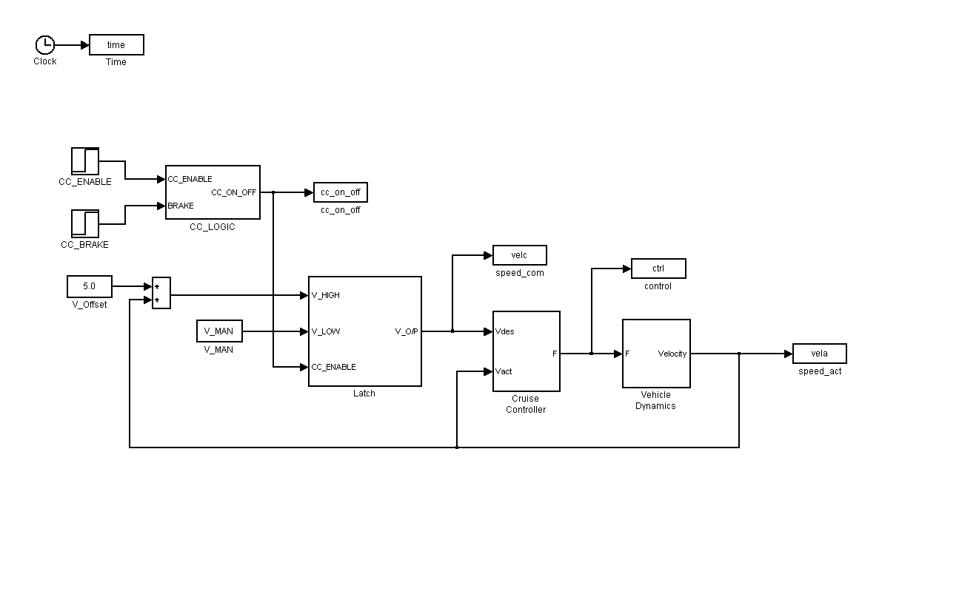
Cruise Controller

Slide 14
Features
Rich Library of standard, customizable blocks
Library includes
  sources (excitation functions, Step, Ramp, etc)
  Sinks (Scopes, printers, files)
  Application specific block sets
    Communication, Control System, DSP Block set,
    Data Analysis Package, CPS, AI/ML
    Verification and Testing

Slide 15
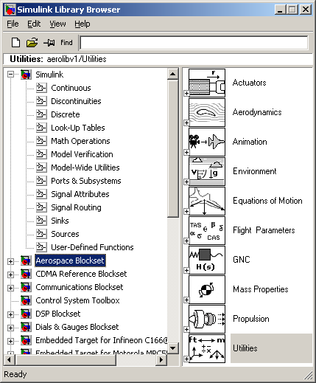

Slide 16
Features
User defined Blocks
Hierarchical Blocks
Subsystems
Masking to hide details

Slide 17
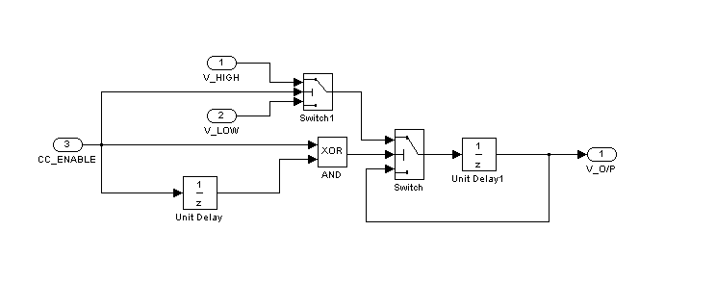
The Latch
Latch

Slide 18
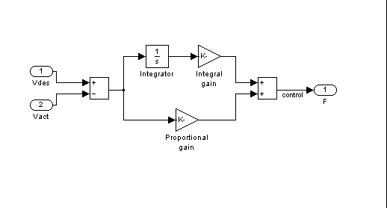
The Controller
PI Controller
E = Vdes – Vact
F = K1 * E+ K2*(Integral of E)

Slide 19
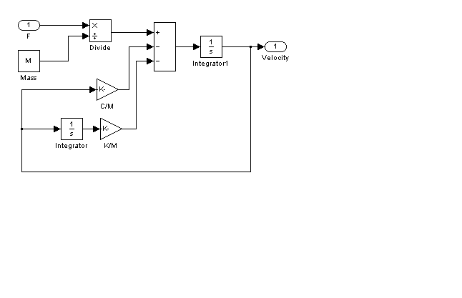
The Plant Model
Plant Model

Slide 20
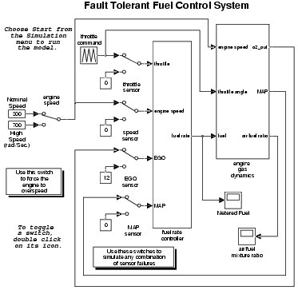
Another Model

Slide 21
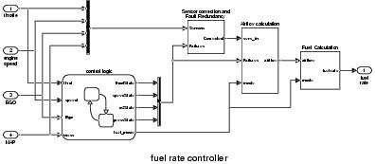
Model Contd.

Slide 22
Block Semantics
I
O
S = (Sc,Sd)
I, O, S are signals
O = out(I,S,t) (output function)
Sc’ = state(I,S,t) (Derivative function)
Next Sd = upd(I,Sd,t)

Slide 23

Model Semantics
Initialization
  Instantiate blocks
  Compute block execution order
  Set Simulation Time step to Start time

Slide 24
Block Execution Order
Blocks are ordered based upon the I/O ordering
  Producer block before consumer block
  Direct feed-through ports/blocks
Blocks w.o. producer – consumer relationship executed in any order
Algebraic Loops are detected – may cause deadlocks

Slide 25

Simulation
Major and Minor Loops
Major Loop
  Repeat
  1. compute next simulation time
  2. update discrete states
  3. execute outputs of blocks
  4. compute cont. states
  until time step = end step
Minor Loop
  Steps 3 and 4 might be repeated for smaller time steps
  For accuracy

Slide 26
Time Steps
Inputs for simulations, besides the model
  Start and End times
  Time Step (Sample Time)
    Fixed or Variable
    Implicit and common for all cont. blocks
    Explicit for Discrete Blocks
    Off-sets

Slide 27
Solvers
Solvers are used for computing the continuous states
Solvers are numerical integration methods
Used for computing the current states by integrating the derivative functions
A Variety of solvers are available
Variable step solvers adjust the step size dynamically when interesting events occur
  Zero crossing detections

Slide 28
Tools
A Variety of Simulation
Model Simulation
Plant-in-loop simulation
Hardware-in-loop simulation (dSpace MicroAutoboxes)
Code Generation also possible
  Real-Time Workshop (RTW), Target-Link

Slide 29
Abstractions
Zero Execution Time
Zero Communication Time
Multiple Block Execution Orders
High Level data types like Signals

Slide 30
Stateflow

Slide 31
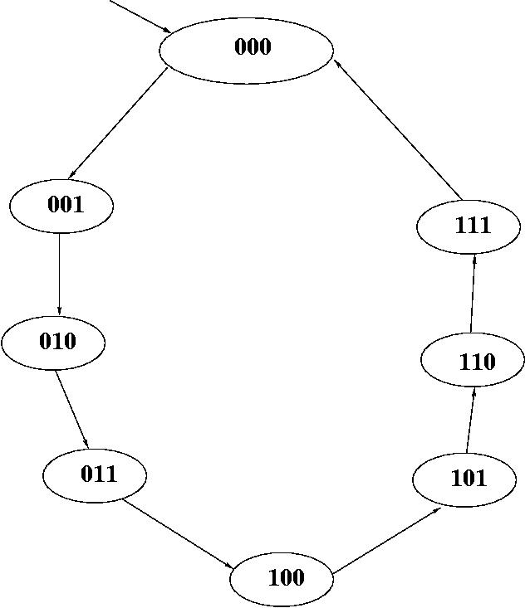
Finite State Machines
One of the well-known models
Intuitive and easy to understand
Pictorial appeal
Can be made rigorous
Standard models for Protocols, Discrete Controllers, Hardware
3 bit counter

Slide 32
Abstract Models
Finite State machine model is abstract
Abstracts out various details
  How to read inputs?
  How often to look for inputs?
  How to represent states and transitions?
  Focus on specific aspects
Easy for analysis, debugging
Redesign cost is reduced
Different possible implementations
  Hardware or Software
  Useful for co-design of systems

Slide 33
Problems with FSMs
All is not well with FSMs
FSMs fine for small systems (10s of states)
Imagine FSM with 100s and 1000s of states which is a reality
Such large descriptions difficult to understand
FSMs are flat and no structure
Inflexible to add additional functionalities
Need for structuring and combining different state machines

Slide 34
Stateflow
Extension of FSMs to have these features
Original idea due to David Harel - Statecharts
Retains the nice features
  Pictorial appeal
  States and transitions
enriched with two features
  Hierarchy and Concurrency
States are of two kinds
  OR state (Hierarchy)
  AND state (concurrency)

Slide 35
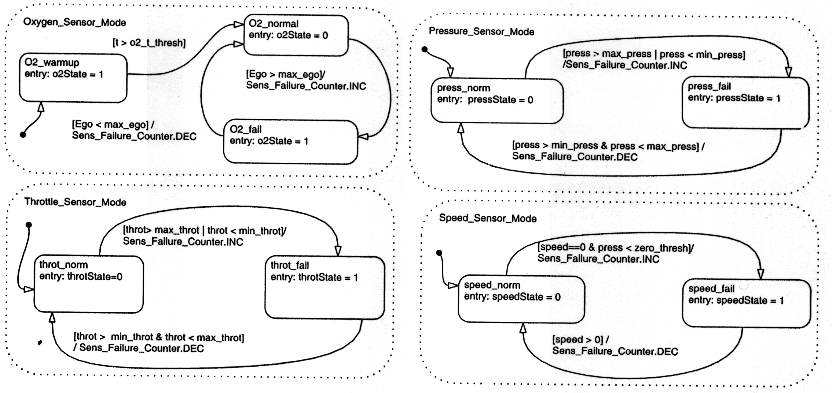
Concurrency

Slide 36
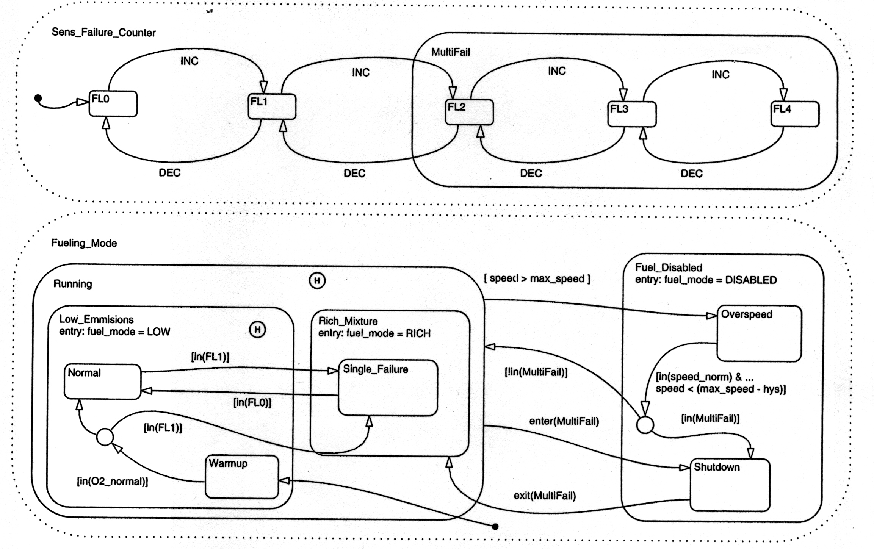
Hierarchy

Slide 37
Communication
Concurrent components of AND state communicate with each other
Taking an edge requires certain events to occur
New signals are generated when an edge is taken
These can trigger further transitions in other components
A series of transitions can be taken as a result of one transition triggered by environment event
Different kinds of communication primitives
More on this later

Slide 38
Summary
Finite number of states
Initial state
No final state (reactive system)
Non determinism (result of abstraction)
Edges labeled with events
Behavior defined by sequences of transitions
Rigorous semantics
Easy to simulate and debug
Automatic Code generation

Slide 39
SCADE/Lustre

Slide 40
Motivation
Simulink/SF defacto standard in control application
but has a number of problems.
its origin in modeling and simulation of complex dynamical system
Is it a programming language?
  Absence of Type safety, modularity,
  Lack of clear semantics
RTW and Target-link code generators exist
How reliable the generated code for safety-critical system?
Stringent guidelines exists for avionics application (DO 178B, SIL)
Emerging for automotive applications too (MISRA, ISO 25257)

Slide 41
SCADE
Conceived as programming langauge with all features
Rigorous mathematical semantics
Do-178B Level A Certified code-generators for avionics applications
Important companies use this language
  Airbus (A 320 – 600, A 380) , Eurocopter
  Dassault Aviation
An alternative to SL/SF

Slide 42
SCADE
A graphical programming environment marketed Ansys Technologies
Strongly influenced by research work from Verimag, Grenoble, France
Like SL/SF, hierarchical block structured language
Discrete Dynamics
Synchronous Semantics
Rigorous Mathematical Semantics

Slide 43
SCADE Blocks
All SCADE blocks are discrete and are of two types:
  Data flow and State machine blocks
State machines are called Synchronous state machines
SSM: Hierarchical and Concurrent State Machines
Rich discrete control constructs derived from Esterel
strong and weak preemptions
Synchronous Concurrency
Broadcast communication

Slide 44
Synchronous State Machines
Inspired by Harel’s Statecharts, like Stateflow
But much cleaner syntax
Clean separation between control and computation
Sound mathematical semantics

Slide 45
Data Flow Blocks
Defined using Lustre (Verimag, France)
Each block corresponds to one or more equations
  O = f(I)
Lustre defines a set of constructs for defining the function f
I
O
f

Slide 46
Lustre Constructs
Lustre has textual syntax.
node EDGE (X: bool) returns (Y: bool);
let
Y = false → X and not pre(X);
tel
X is an input variable and Y, output variable.
Each Lustre variable is a flow or a stream (infinite sequence of values)
  X and Y are boolean flows, eg. (true, false, false, true, . . . )
`pre’ and `→’ are flow operators
  pre(0,1,2,3,. . . ) = (nil,0,1,2,3,. . . )
  f → (t, f, f, t, . . . ) = (f, t, f, f, t, . . . )
`and’, `not’ are boolean operators extended to streams
The above program defines the (infinite) boolean flow Y as a function of another boolean flow X.

Slide 47
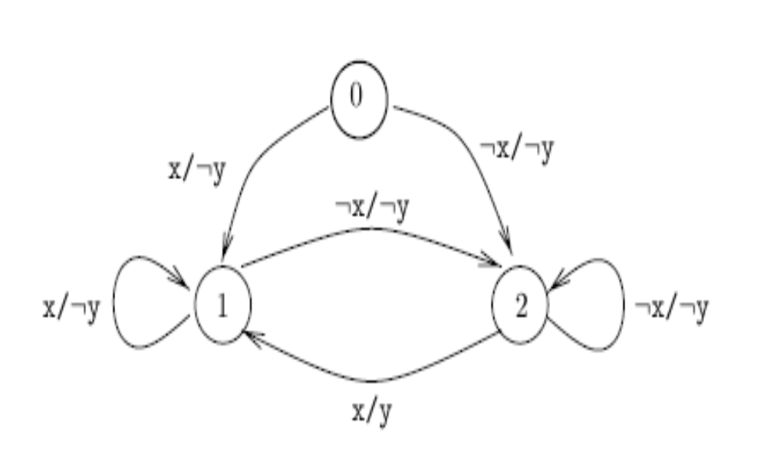
Behaviour of Edge
  The value of Y at some point is true iff the current value and the previous value of X are true
  Initially Y holds the value `false’

Slide 48
Another Example
Reuse of programs
node FALLING_EDGE (X: bool) return (Y: bool);
let
Y = EDGE(not X);
tel

Slide 49
Another Example
node SWITCH (set, reset, initial: bool) returns (level: bool);
let
level = initial -> if set then true
else if reset then false
else pre(level);
tel
Note the `if-then-else’ control construct

Slide 50
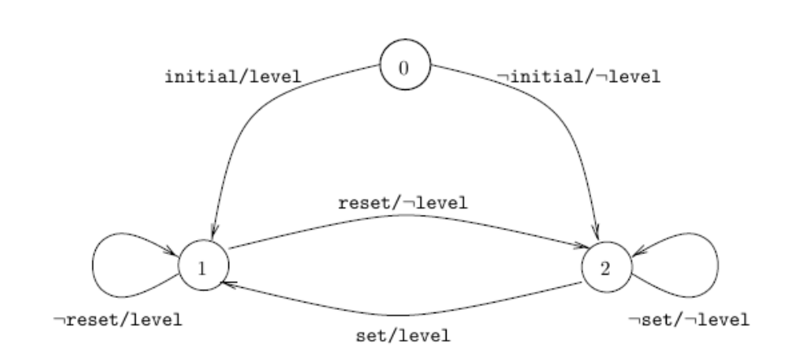
Switch Automaton

Slide 51
A Numerical Example
C counts the number of true occurrences of X
PC = 0 -> pre C;
C = if X then (PC + 1) else PC;

Slide 52
A Complex Counter
node COUNTER(init, incr : int; X, reset : bool)
returns (C : int);
var PC : int;
let
PC = init -> pre C;
C = if reset then init
else if X then (PC + incr)
else PC;
tel

Slide 53
An Integrator Node
F^{n} = f(x^{n}) and x^{n+1} = x^{n} + STEP^{n+1}
Y^{n+1} = Y^{n} + (F^{n} + F^{n+1}) * STEP^{n+1}/2
X and Y are real valued
node integrator(F, STEP, init: real)
returns (Y: real);
let
Y = init -> pre(Y) + ((F+pre(F))*STEP)/2.0;
tel

Slide 54
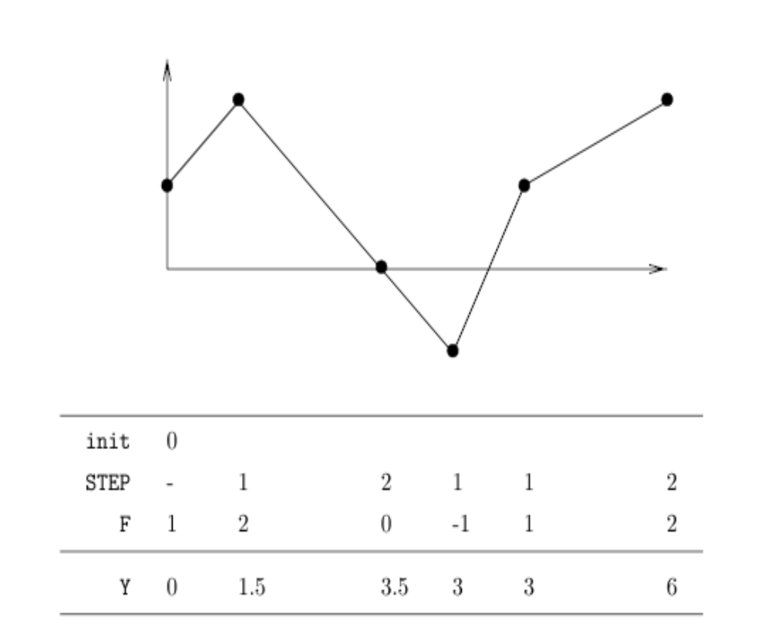
Pictorially . . .

Slide 55
Interconnection of Scade blocks
One block’s output can be connected to another block’s input
Semantics of interconnection is just union of equations
  O1 = f(I)
  O = g(I)
No implicit buffers
Which value of O1 is fed to g is decided by explicit rules of the language:
  Flows are associated with clocks
I
O1
O
f
g

Slide 56
Clock Calculus
All inputs have the same clock called the basic clock
(Intermediate) outputs have same or sub-clocks
Sub clocks are defined using boolean flows
x = 2 3 4 1 0 2 2 . . .
b = 1 0 0 1 0 1 1 . . .
x when b = 2 1 2 2 . . .
In equations like z = x + y, x, y and x should have the same clock
Clocks are essentially boolean flows and define the frequency of execution of the blocks and interconnections define the order of the execution

Slide 57
Cyclic Dependencies
Consider
  X = Y + Z
  Y = X * Z
The current value of X depends on Y which in turn depends upon X
The flows of X and Y are undefined and rejected by the compiler
Consider
  X = Y + Z
  Y = pre(X) * Z
There is no cycle here and is well-defined

Slide 58
More of Lustre
More complex data values, like tuples, arrays can be defined
Lustre program can be simulated
  Give a sequence of inputs and the simulator produces the sequence of outputs produced by the Lustre program simulated
Formal verification – observer based verification (assertion based verification)
Autocode generation of C, C++ code from Lustre

Slide 59
Summary
Various models reviewed
  State machines, Stateflow, Simulink
  SCADE, Synchronous State Machines, Lustre
SCADE has a clean syntax and mathematical semantics
Has been used successfully in many avionics application
SCADE environment has support for simulation, formal verification and auto-code generation.
DO-178 certified code generator
Safety-critical applications can be developed using SCADE
Simulink/SF front-end has been recently added to Scade

Slide 60
References
S.A. Edwards, Languages for Digital Embedded Systems, Barnes & Noble, 2000.
D. Harel et al., STATEMATE: a working environment for the development of complex reactive systems, IEEE Trans. Software Engineering, Vol. 16 (4), 1990.
Simulink and Stateflow, www.mathworks.com
Gilles Kahn, David B. MacQueen: Coroutines and Networks of Parallel Processes. IFIP Congress 1977: 993-998
E. A. Lee and David G. Messerschmitt, Synchronous Data Flow, Proceedings of the IEEE, Sept., 1987
A. Benveniste et al., Synchronous Technology for Real-Time Systems, Proceedings of Real-Time Systems'94", North-Holland, 1994

